Slide 1
IMDB MOVIE RATING PREDICTION
Submitted By,
Sanath Davis
Riya Xavier
Abishek Kailasam
Bindia Biju
Final Project Presentation
AIDI-1002-01 AI ALGORITHMS
Under the Guidance of Prof. Dr. Mizan

Slide 2
Introduction
Nowadays movies are no longer the means of entertainment.
Movies arouse fresh passion among young people.
Most people watch movies online.
We can publish movie reviews on websites like IMDb,Metacritics,etc.
The purpose of our project is to forecast movie ratings by analysing movie rating data.

Slide 3


Slide 4
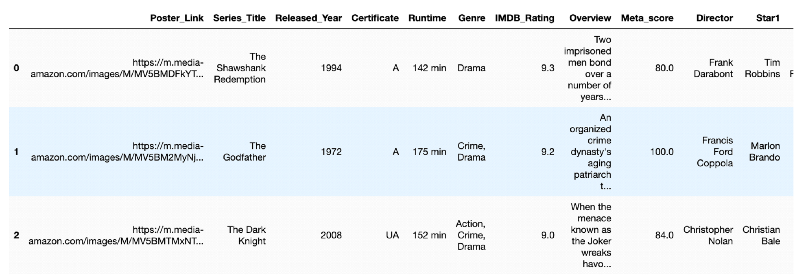
Exploratory Data Analysis(EDA)
The IMDb dataset contains 1000 rows and 16 columns

Slide 5
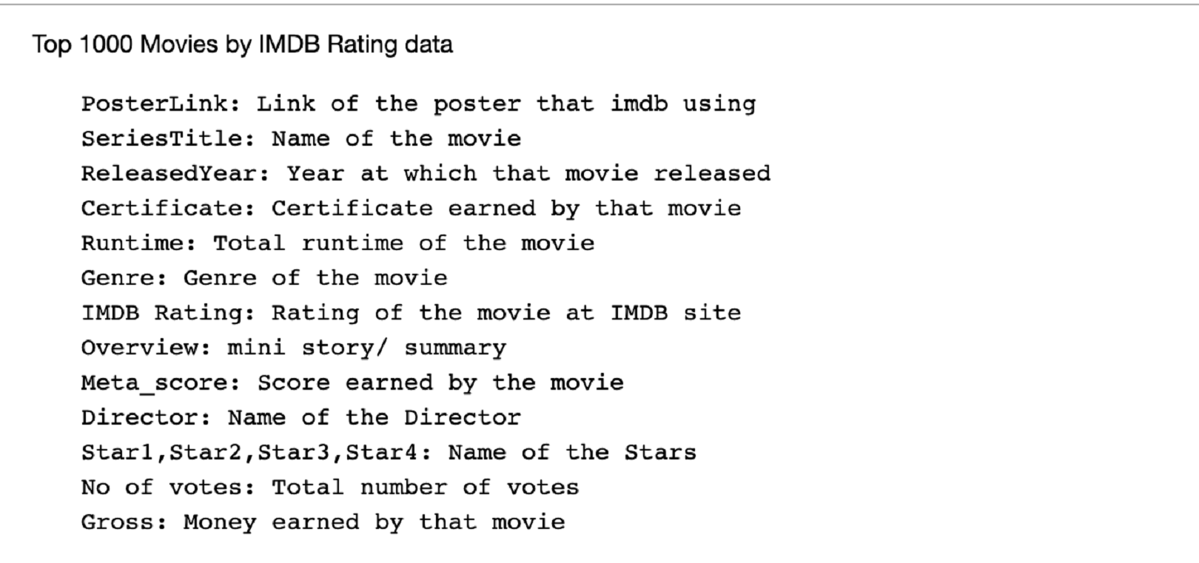
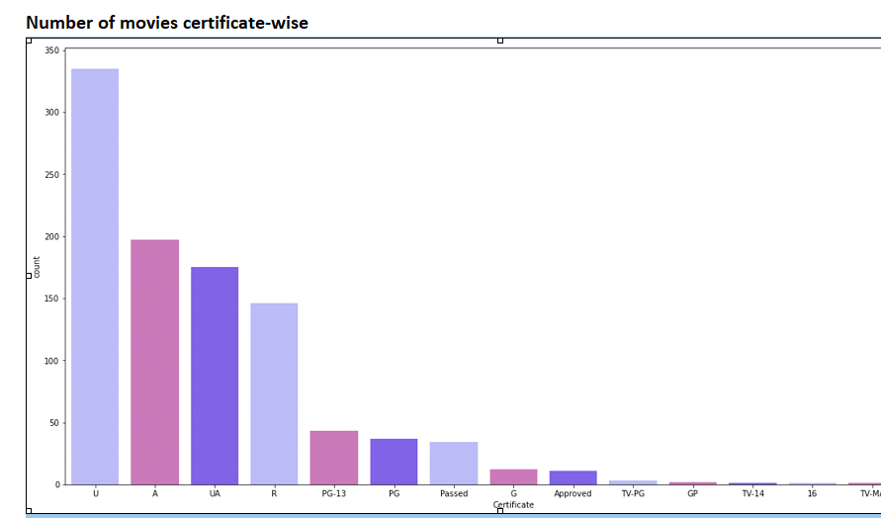
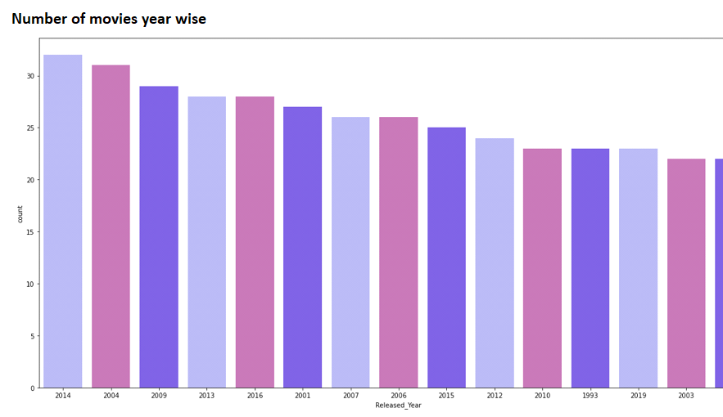
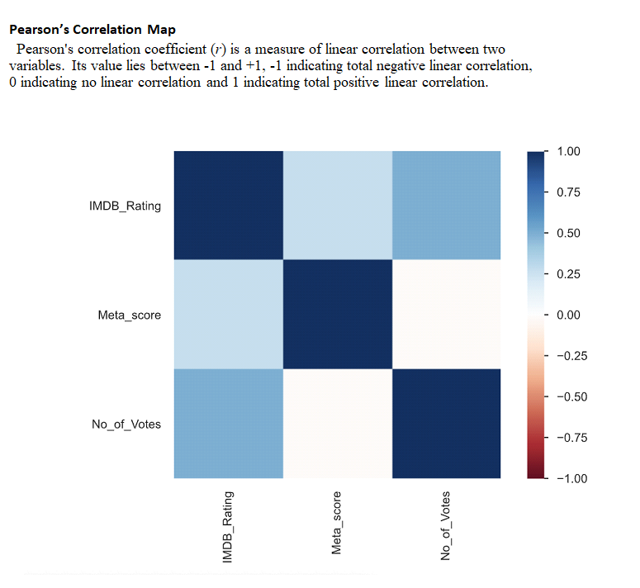
Second point
Columns of the Dataset:
Some of the graphs obtained are:

Slide 6
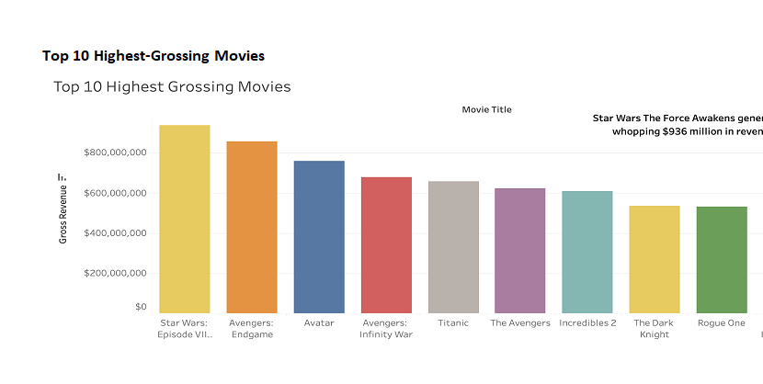
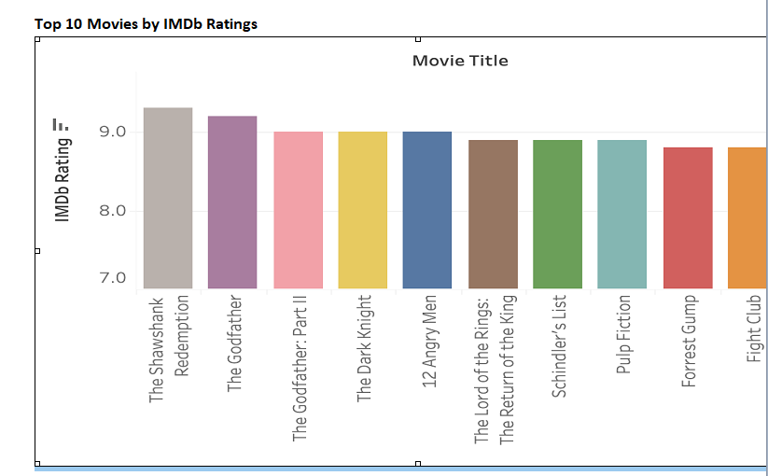
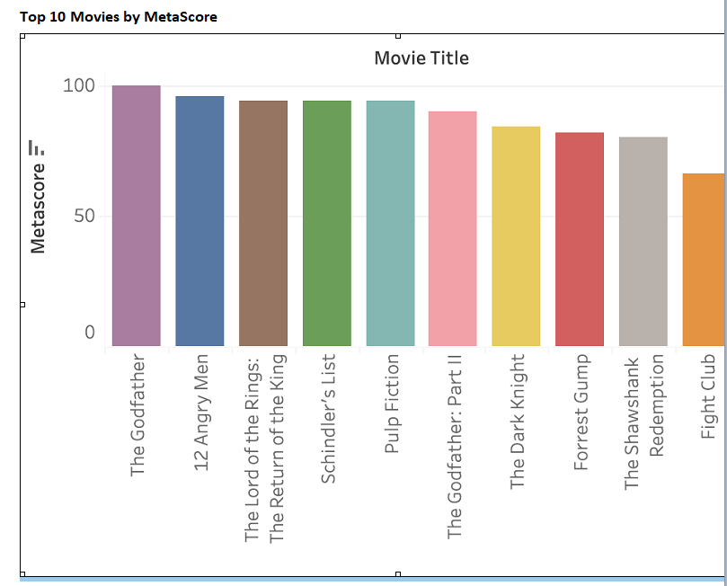
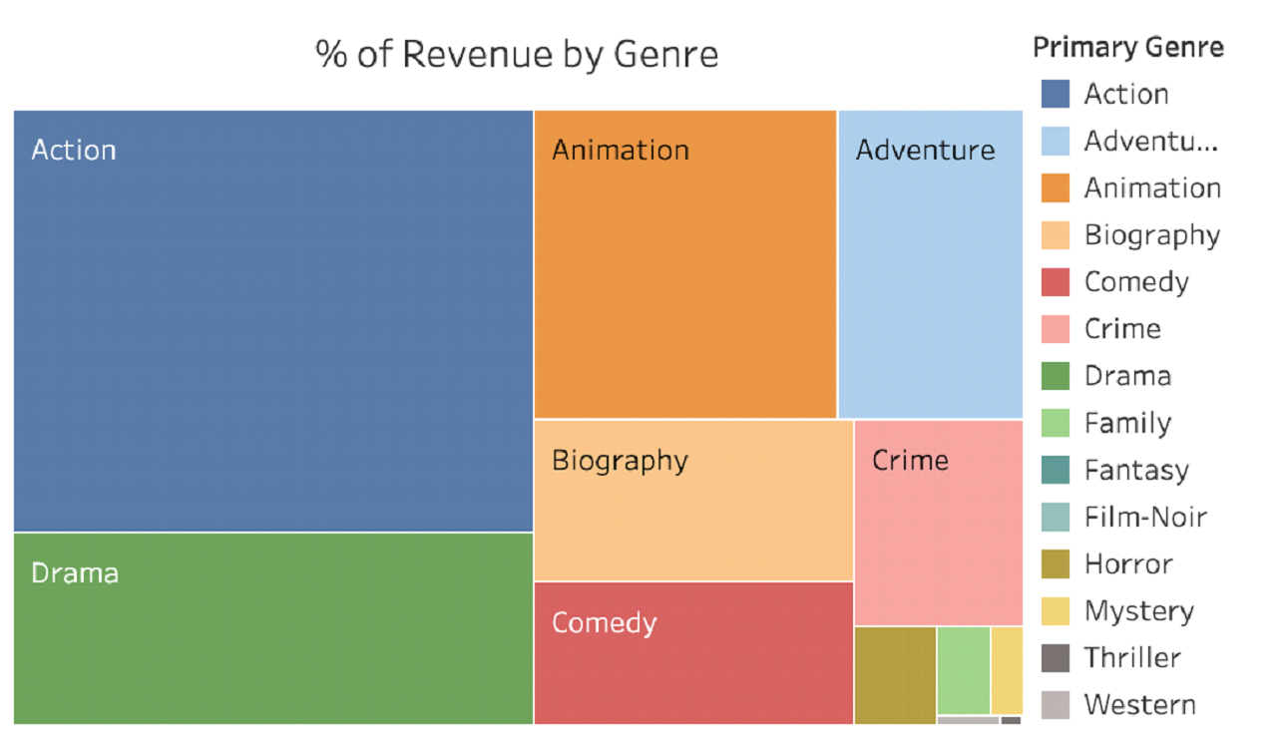

Slide 7
Modelling Approach
We have decided to build below-mentioned models for our project:
⦁ Linear Regression
⦁ Random Forest Regressor
⦁ XGBoost Regressor
Main focus is on Random Forest and XGBoost Ensemble technique.
We will compare the error rates with all of the above models
Finally we will choose the best performing model
Steps involved in our prediction are:

Slide 8
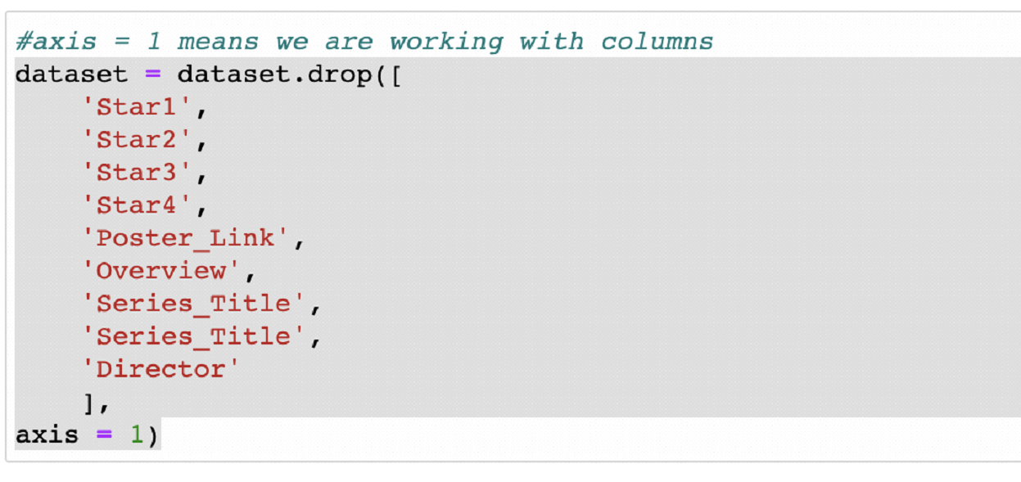
1.Data Preparation
Checked to see if there are any unwanted columns in our dataset.
We found some columns that are not important for our analysis, hence dropped them.

Slide 9
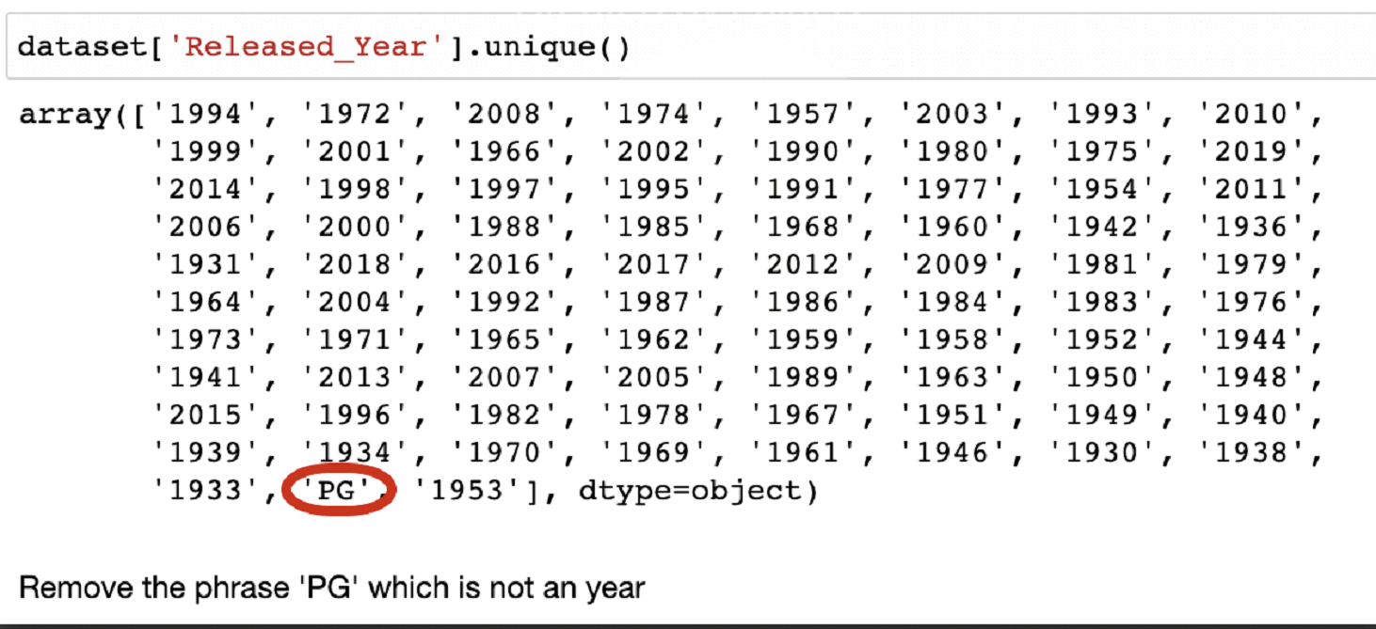
We found that there were 169 records with NULL values.
These were the values for revenue of movies. We went ahead and dropped those rows of data.
Then we found an unrelated entry in Year column.

Slide 10
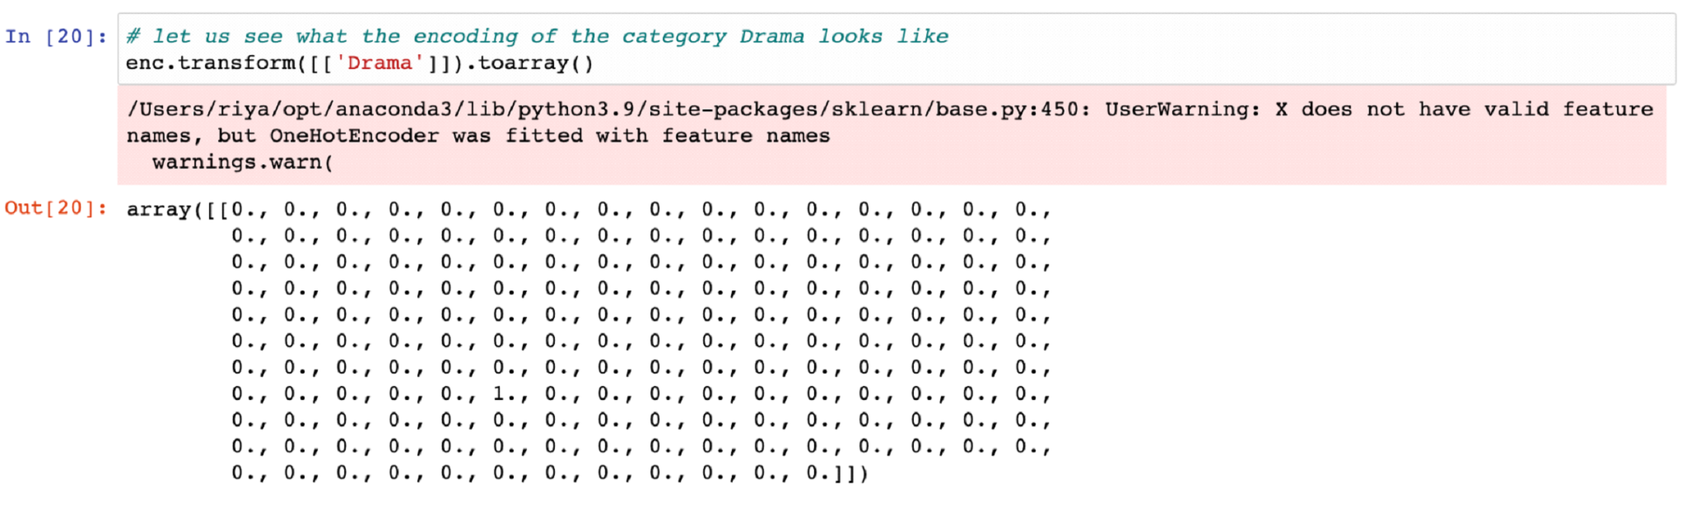
2.Encoding
A single movie can have multiple genres, but this will be difficult to work on.
We use encoding techniques on the Genre and Certificate column to convert into numerical values.
For this we used One Hot Encoding technique.

Slide 11
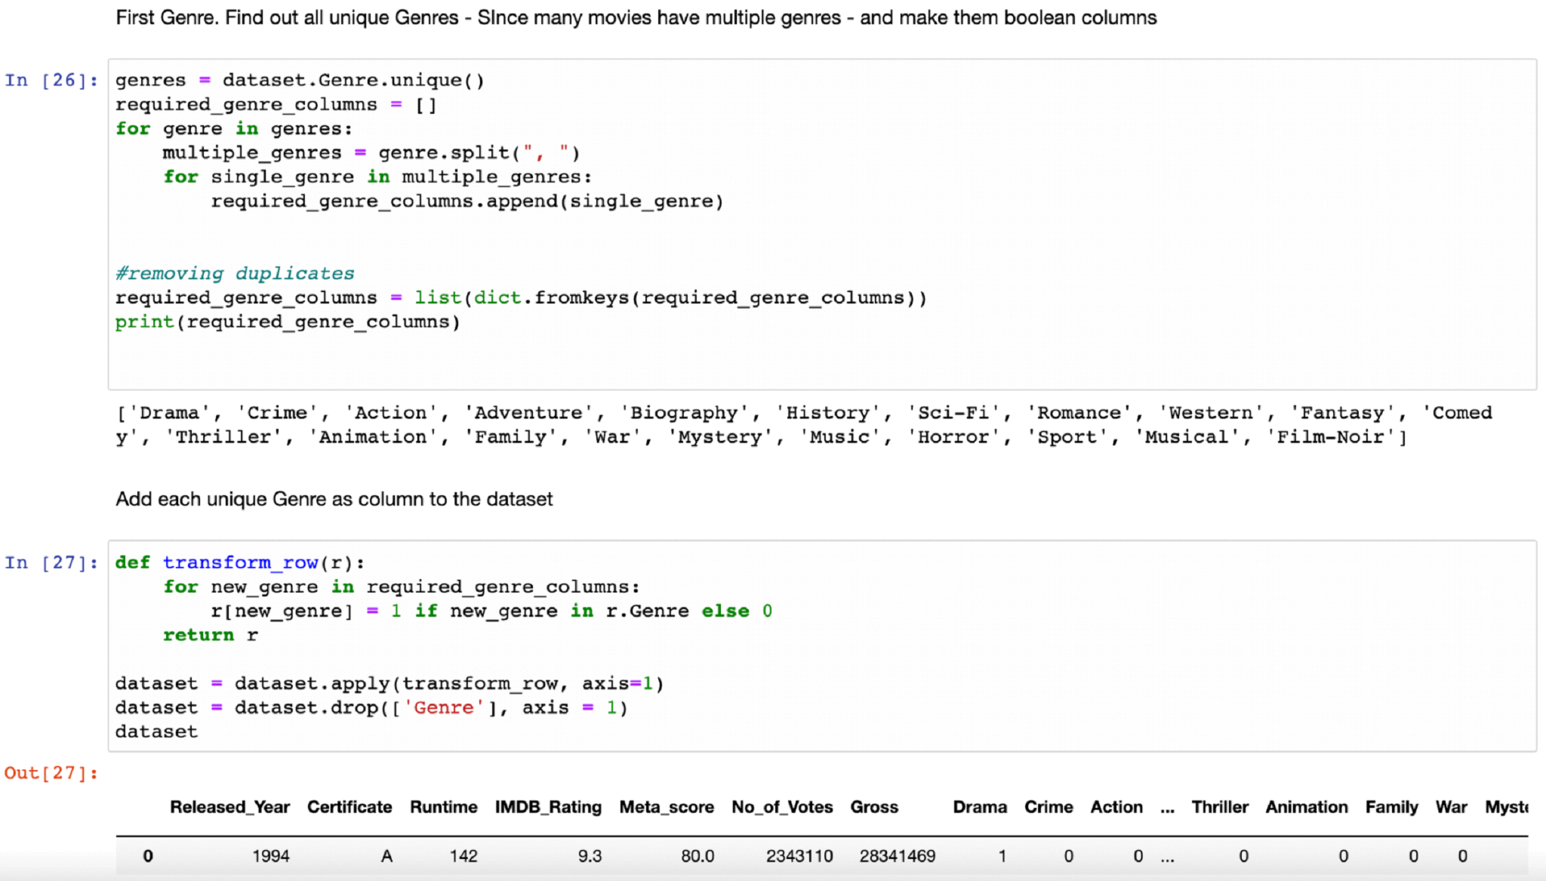
One Hot Encoding was not successful due to the presence of multiple values for Genre.
Hence we encoded manually.

Slide 12
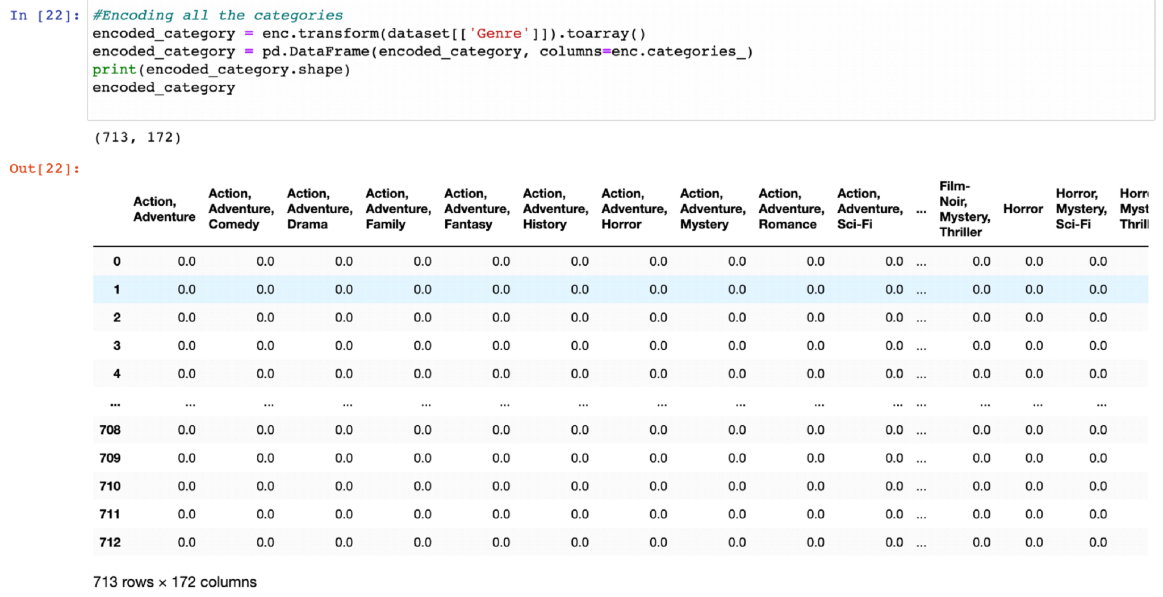

Slide 13
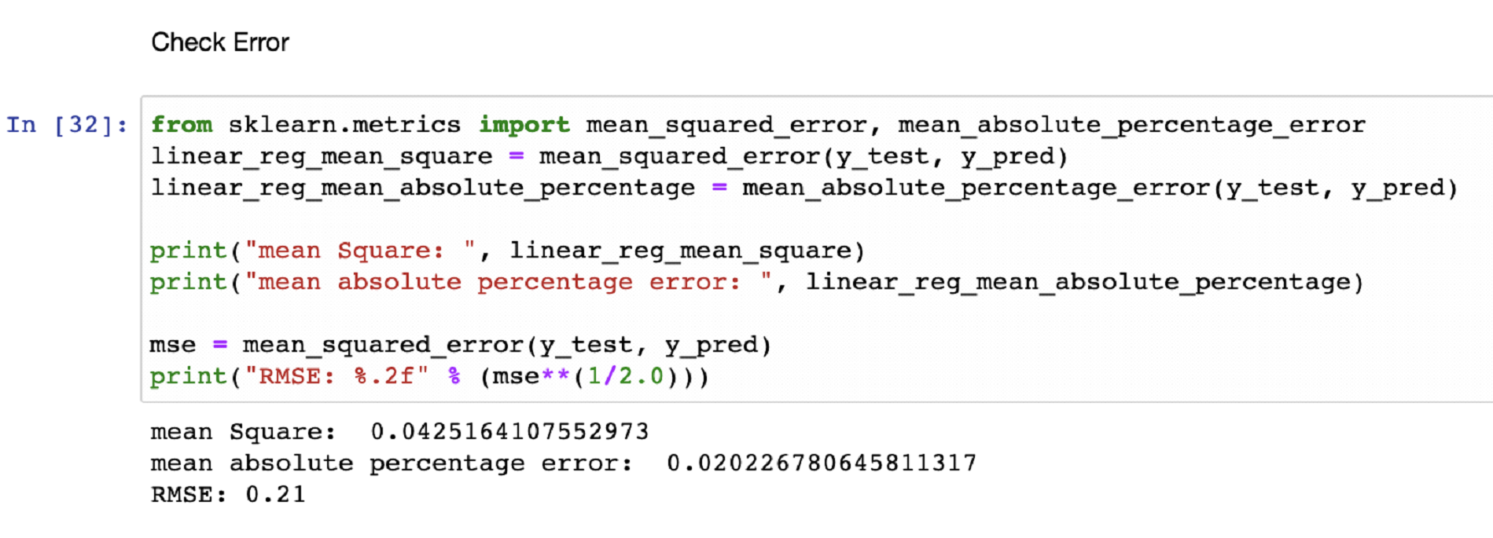
3.Model 1 - Linear Regression
For Linear Regression, we split the dataset as 60:40 for train and test and apply the model.

Slide 14
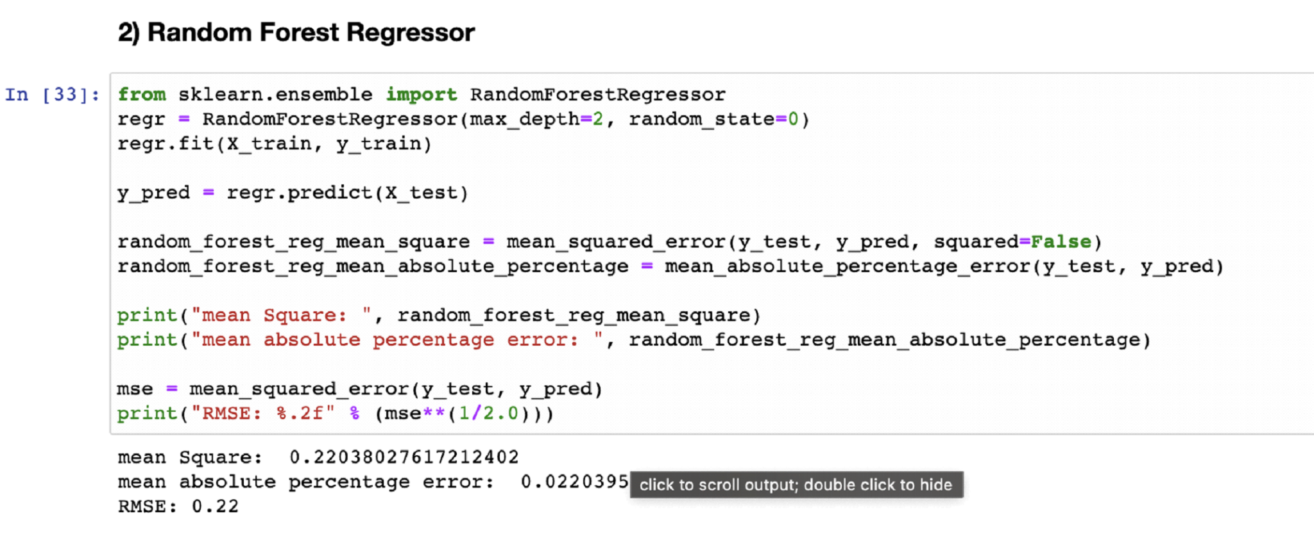
4.Model 2 - Random Forest Regressor

Slide 15
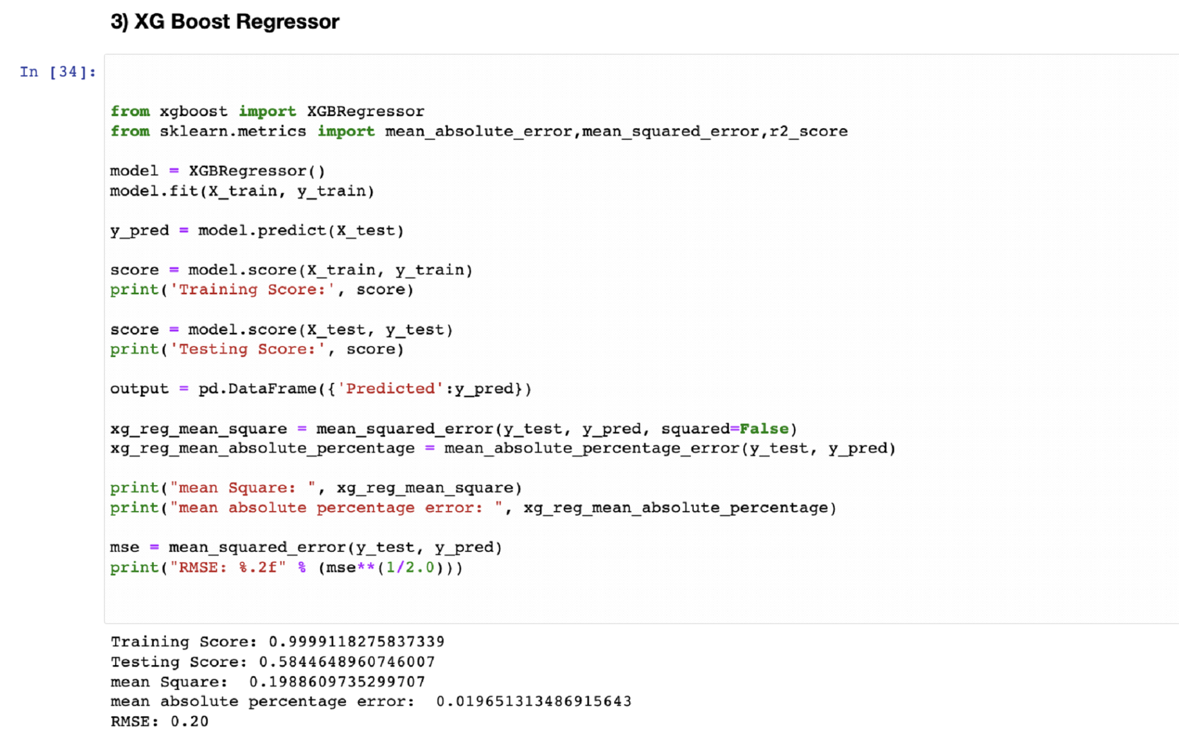
5.Model 3 - XG Boost Regressor

Slide 16
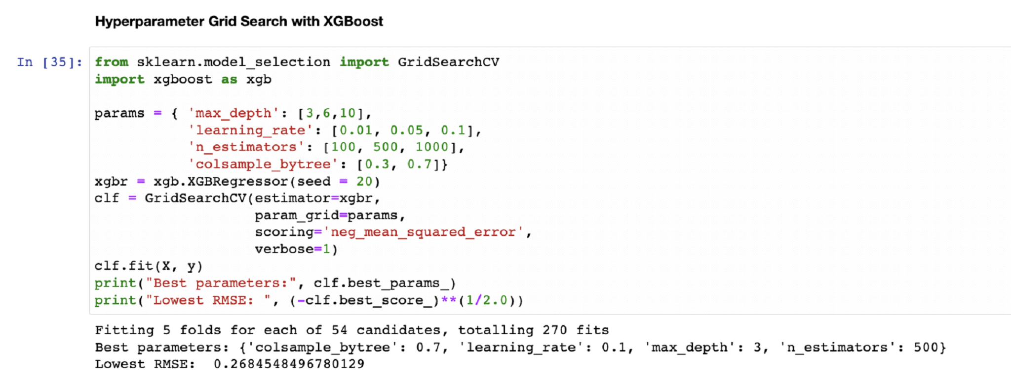
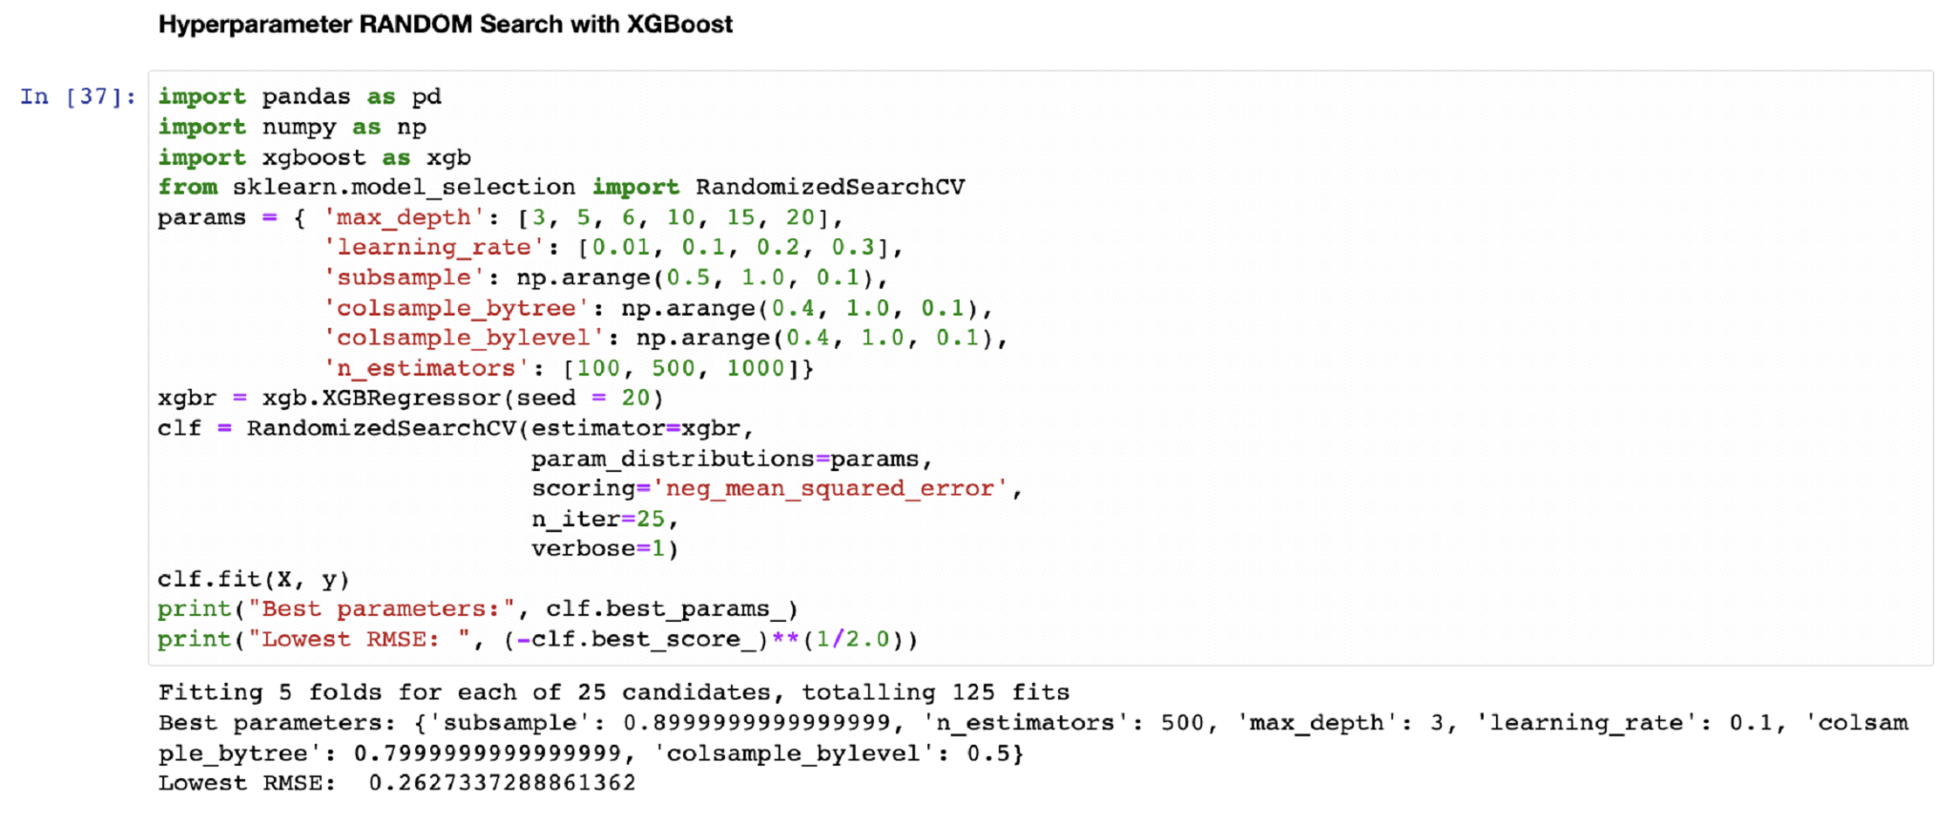
6.Hyper Parameter Tuning with grid and random search

Slide 17
Conclusion
There are three error metrics that are commonly used for evaluating and reporting the performance of a regression model; they are:
⦁ Mean Squared Error (MSE).
⦁ Root Mean Squared Error (RMSE).
⦁ Mean Absolute Error (MAE)

Slide 18
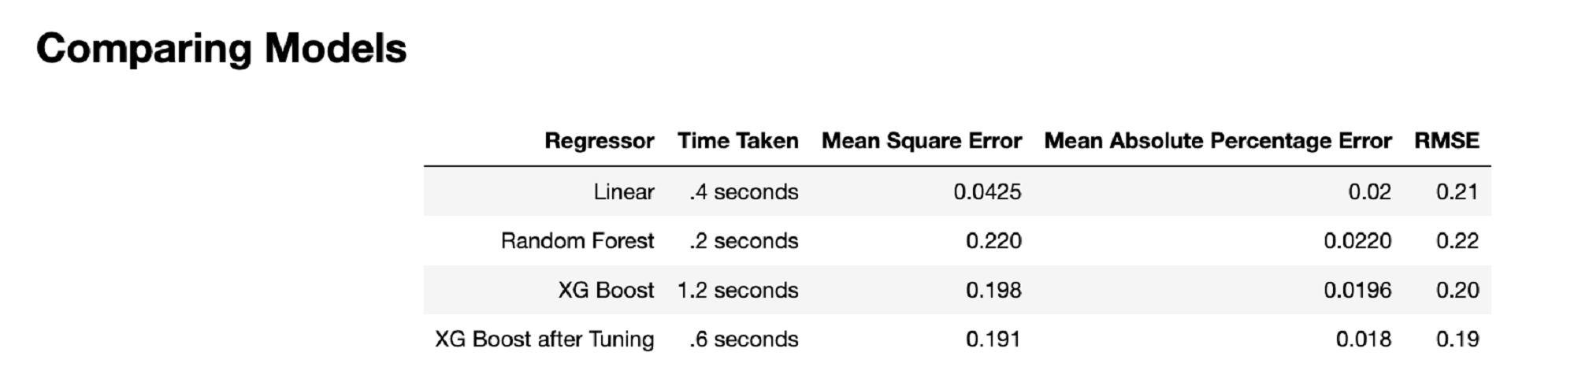
We came to the conclusion that error rates are least for XGBoost with Hyperparameter Tuning.
Hence, we can use this model for our prediction system.

Slide 19
Ethical issues
The number of false movie ratings is a crucial ethical problem to take into account. For instance, an movie producer may encourage favorable ratings to alter customer perception in order to boost the possibility that a consumer will see a movie. Such dishonest action is both immoral and against the law. Sadly, false reviews might go unreported, leading to bias in our model.

Slide 20
Thank You

